Slide 1
Permutation Test and P- Values

Slide 2
P- Values
What P- Value is?
The probability of obtaining a result equal to or "more extreme" than what was actually observed, when the null hypothesis is true.
What P- Value is not?
P Values Are NOT the Probability of Making a Mistake
1-p is not a probability of null hypothesis being false

Slide 3
Permutation Test
We packaged the code for permutation tests.
Commands to install the package:
install.packages("devtools")
devtools::install_github("devanshagr/PermutationTestSecond")
Run Permutation test as follows:
PermutationTestSecond::Permutation(TRAFFIC, "TUNNEL", "VOLUME_PER_MINUTE",1000,"Holland", "Lincoln")
To run the permutation test once:
devtools::install_github("devanshagr/PermutationTestManual")
PermutationTestManual::permute_test(TRAFFIC, "TUNNEL", "VOLUME_PER_MINUTE", "Holland", "Lincoln")

Slide 4
Running the Permutation Test
p value from Permutation Test is 0.
Notice how Z Test and Permutation Test return similar p values.

Slide 5
Exercise: Compute P-Values for Happiness Dataset
Claim/Hypothesis: People in Philippines are happier compared to people in Australia.
P value from permutation test is 0
We can make a claim that people in Philippines are happier compared to people in Australia

Slide 6
Exercise: Compute P-Values from Zodiac Challenge
Hypothesis: Capital Gains in US are higher than Capital Gains in Columbia
Using Permutation Test

Slide 7
Exercise: Compute P-Values from Zodiac Challenge
Hypothesis: Capital Gains in US are higher than Capital Gains in Columbia
p value in this case is 0.047
We found good evidence to support our hypothesis that Capital Gains in US are higher than Capital Gains in Columbia

Slide 8
Exercise: Compute P-Values from Zodiac Challenge
Using z-test

Slide 9
What do we observe?
P- Value from Z-test: 0.01
P- Value from Permutation Test: 0.047 (after 1000 iterations)
A low difference in means results in higher P- Value
Note: The p-values that you obtain each time you run permutation test for lower number of iterations(such as this case) may differ(sometimes significantly). This is because, lower the number of permutations, more are the options available to choose from all combinations. So we may sample highly different data each time.
Notes:
P value of permutation test that you are getting may vary because of large variance

Slide 10
More Analysis
Number of Permutations | P- Value
10 | 0.1
100 | 0.06
500 | 0.042
1000 | 0.048
2000 | 0.0405
5000 | 0.0488
10000 | 0.0464

Slide 11
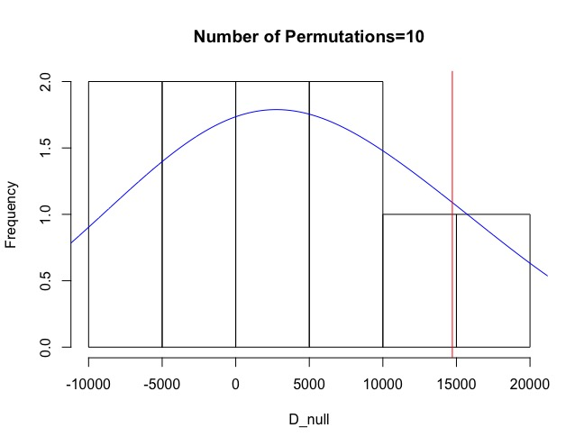
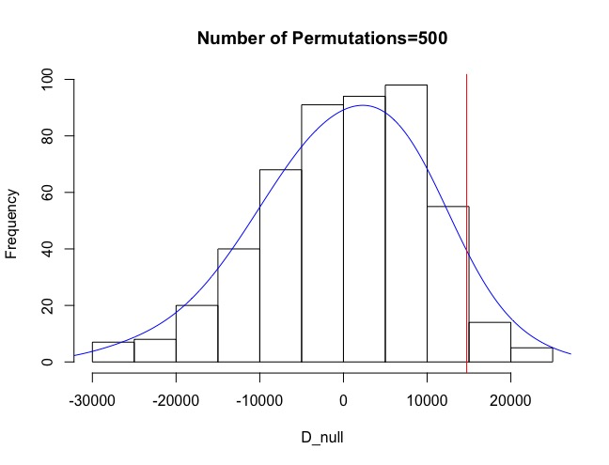
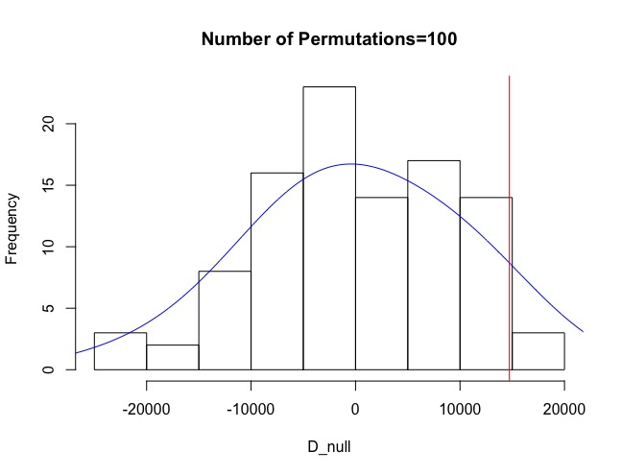
Distribution of Diff. of Means
Histograms of difference of means for different number of permutations.

Slide 12
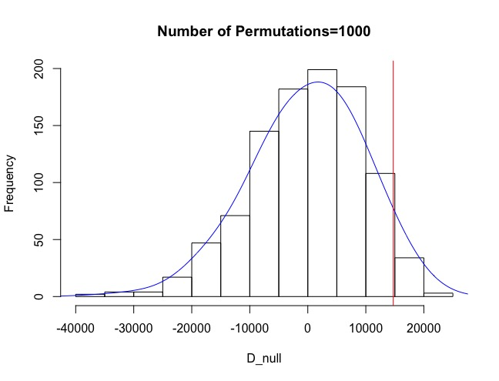
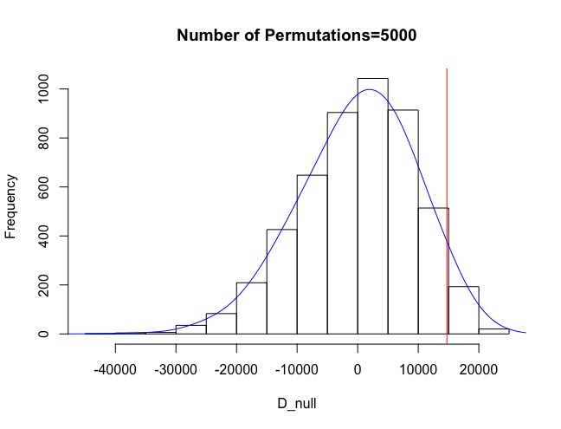
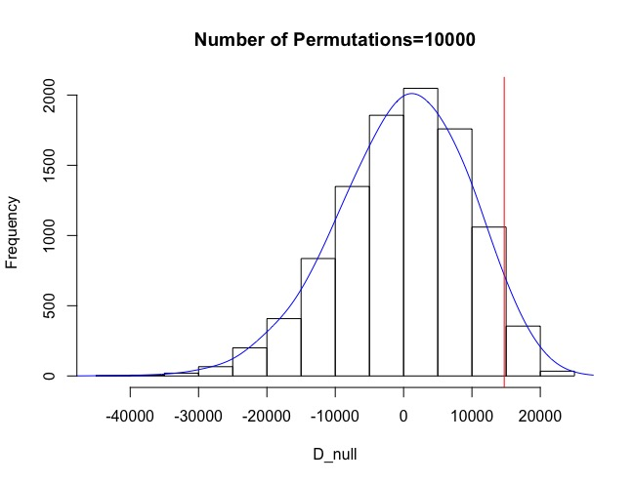
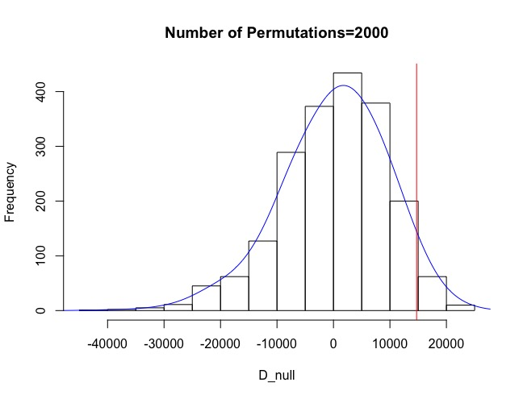
As can be seen, with larger number of samples, the distribution of means converges more and more towards normal distribution (central limit theorem). This also explains why we get different p values for each run for lower number of permutations. This is because the normal distribution for lower number of permutations has a wider spread, and so the spread between p values obtained is also high. As the number of permutations increase, the width becomes narrower and so the spread between p values obtained also becomes low.

Slide 13
Question 1
A p-value of 0.05 means: (a) There is a 95% chance that our claim is correct.
(b) There is a 5% chance that our claim is correct.
(c) If null hypothesis was true, then we’d expect to encounter a result equal or more extreme that we observed no more than 5% of the time.
(d) The results are random.

Slide 14
Answer
A p-value of 0.05 means: (a) There is a 95% chance that our claim is correct.
(b) There is a 5% chance that our claim is correct.
(c) If null hypothesis was true, then we’d expect to encounter a result equal or more extreme that we observed no more than 5% of the time
(d) The results are random.

Slide 15
Question 2
The goal of a permutation test is to: (a) Prove that the null hypothesis is true.
(b) Show how often the observed results could happen by chance.
(c) Prove that the order in which elements are added to the dataset is irrelevant.
(d) Show that every permutation of the dataset gives the same results.

Slide 16
Answer
The goal of a permutation test is to: (a) Prove that the null hypothesis is true.
(b) Show how often the observed results could happen by random chance.
(c) Prove that the order in which elements are added to the dataset is irrelevant.
(d) Show that every permutation of the dataset gives the same results.

Slide 17
Question 3 (P-Value using Z score)
When comparing happiness levels in US and Canada. 500 Americans and 100 Canadians are
randomly selected from each country. The sample mean difference of happiness levels of
Americans and Canadians is 0.15. The standard deviation of American sample is 1 and the
standard deviation of Canadian is 0.4.
CLAIM: Americans are happier than Canadians

Slide 18
Answer
Z= 2.5
P= 1-0.9938 = 0.0062

